Slide 1
Density Based Spatial Clustering of Application with Noise

Slide 2
Table of Content
Introduction to DBSCAN
Key Concept of DBSCAN
How DBSCAN works
Advantages of DBSCAN
Disadvantages of DBSCAN
Python Implementation
Optimization
Reference

Slide 3
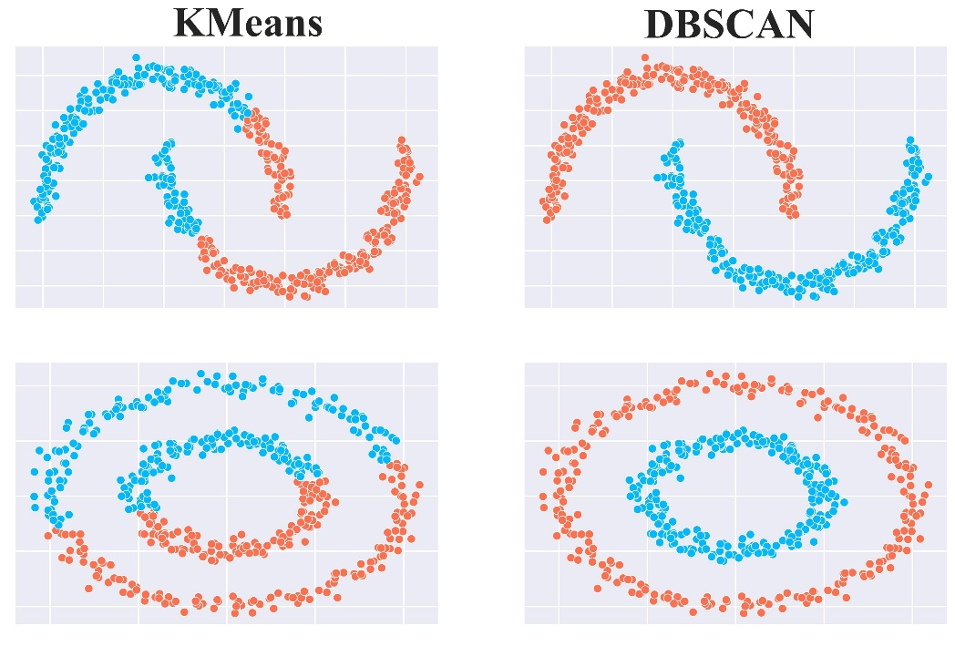
Introduction to DBSCAN
DBSCAN is one of the clustering techniques which can be used for clustering data points based on density. It works by distinguishing clusters as regions of high density seperated by areas of low density. Unlike Kmeans which assumes spherical shaped clusters or convex clusters. DBSCAN can can identify clusters of arbitrary shape, making it more versatile.

Slide 4
Key Concepts of DBSCAN
1. Epsilon (ε): This is a distance threshold defining the neighborhood around a data point. Two points are considered neighbors if the distance between them is less than or equal to ε.
2. MinPts: This is the minimum number of data points required in a neighborhood to form a dense region. If a point has at least MinPts points within its ε-radius (including itself), it is considered a core point.
3. Core Point: A data point is a core point if it has at least MinPts points within its ε-neighborhood.
4. Border Point: A point that is not a core point but falls within the ε-neighborhood of a core point.
5. Noise Point (Outlier): A point that is neither a core point nor a border point. Noise points are considered outliers in the dataset.

Slide 5
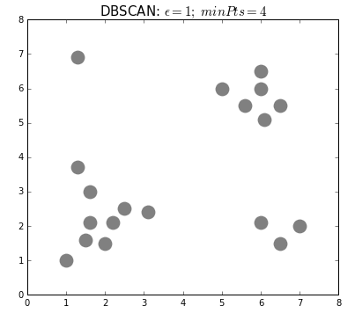
How DBSCAN Works
Initialization: Start with an arbitrary data point that has not been visited.
Neighborhood Query: Find all points within a distance ε from the starting point (neighbors).
Core Point Check: If the starting point has MinPts or more neighbors, it is a core point, and a new cluster is initiated. Otherwise, the point is labeled as noise. Later, this point might be included in a cluster if it is within the ε-neighborhood of a core point.
Expand Cluster: Recursively add all density-reachable points (points within ε-distance of core points) to the cluster until no more points can be added.
Move to Next Point: Repeat the process for the next unvisited point, leading to the discovery of another cluster or noise.

Slide 6
Advantages of DBSCAN
1. Discovering Arbitrarily Shaped Clusters: Unlike K-Means, which assumes spherical clusters, DBSCAN can find clusters of any shape.
2. Handling Noise: DBSCAN can identify outliers, making it robust in the presence of noise.
3. No Need to Specify Number of Clusters: DBSCAN does not require specifying the number of clusters beforehand, unlike K-Means.
Disadvantages of DBSCAN
1. Choosing Parameters: Selecting appropriate values for ε and MinPts can be challenging and data-dependent.
2. Performance on Varying Density: DBSCAN may struggle with datasets containing clusters of varying densities.
3. Computational Complexity: DBSCAN can be computationally expensive for large datasets due to the need to compute distances between all pairs of points.

Slide 7
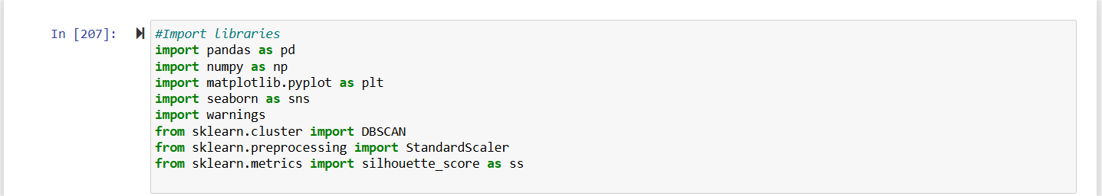
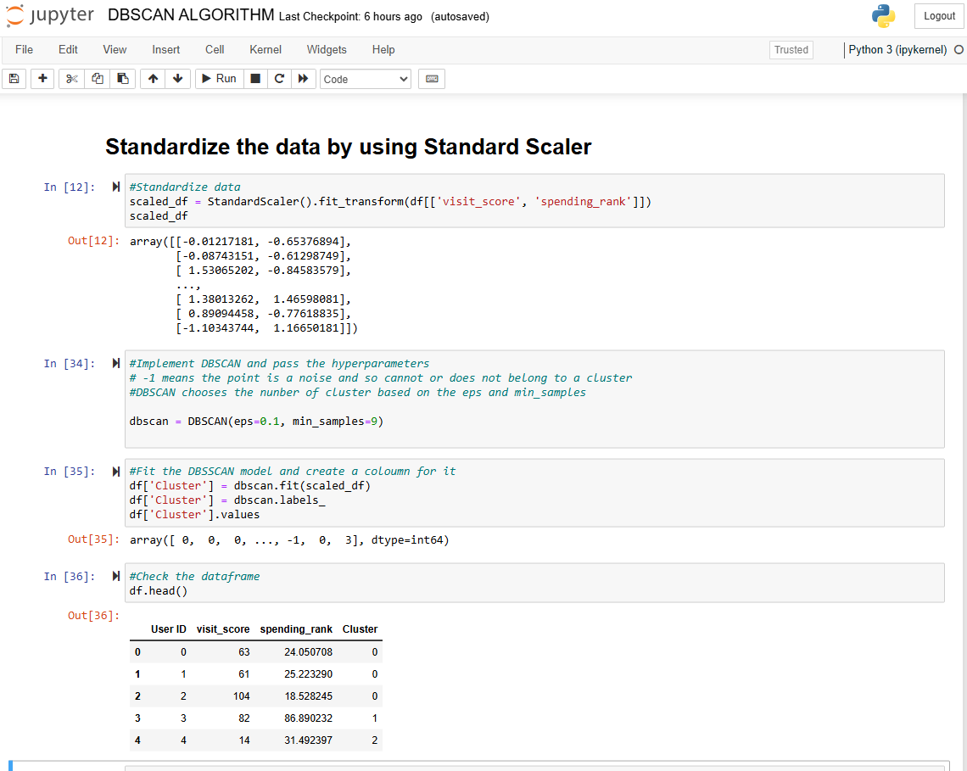
HOW THE ALGORITHM WORKS

Slide 8
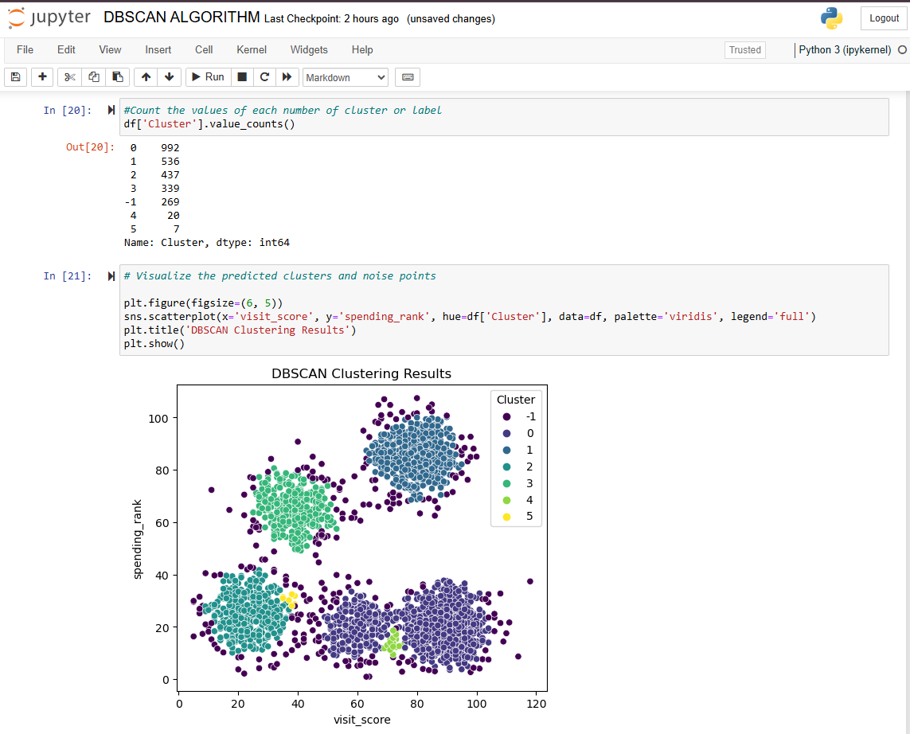
HOW THE ALGORITHM WORKS
eps = 0.1, min_samples = 9
Silhouette score = 0.218

Slide 9
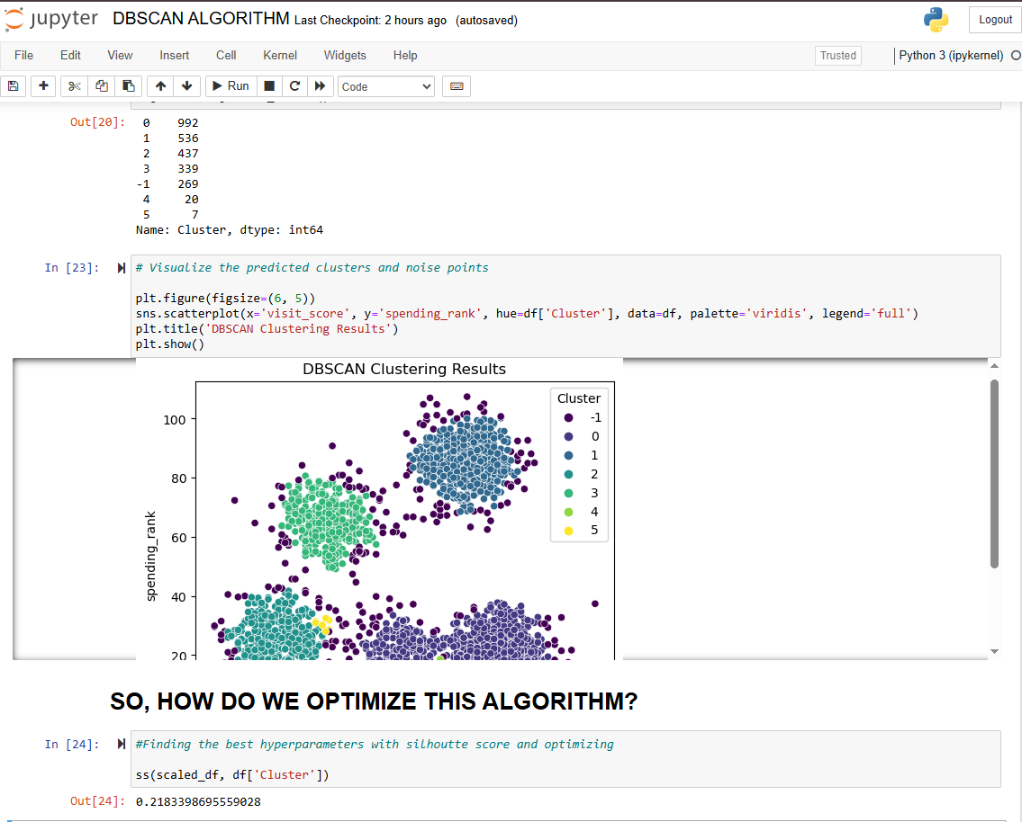
HOW THE ALGORITHM WORKS

Slide 10
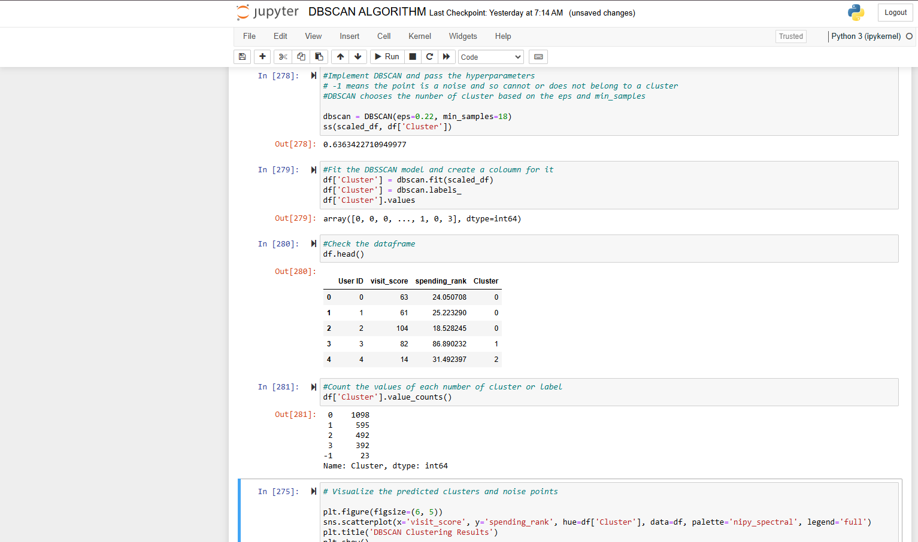
HOW THE ALGORITHM WORKS

Slide 11
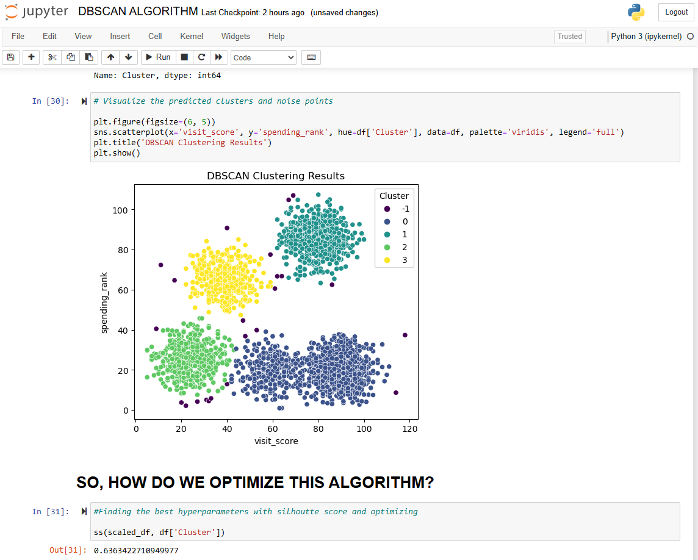
HOW THE ALGORITHM WORKS
eps = 0.22, min_samples = 18
Silhouette score =0.636

Slide 12
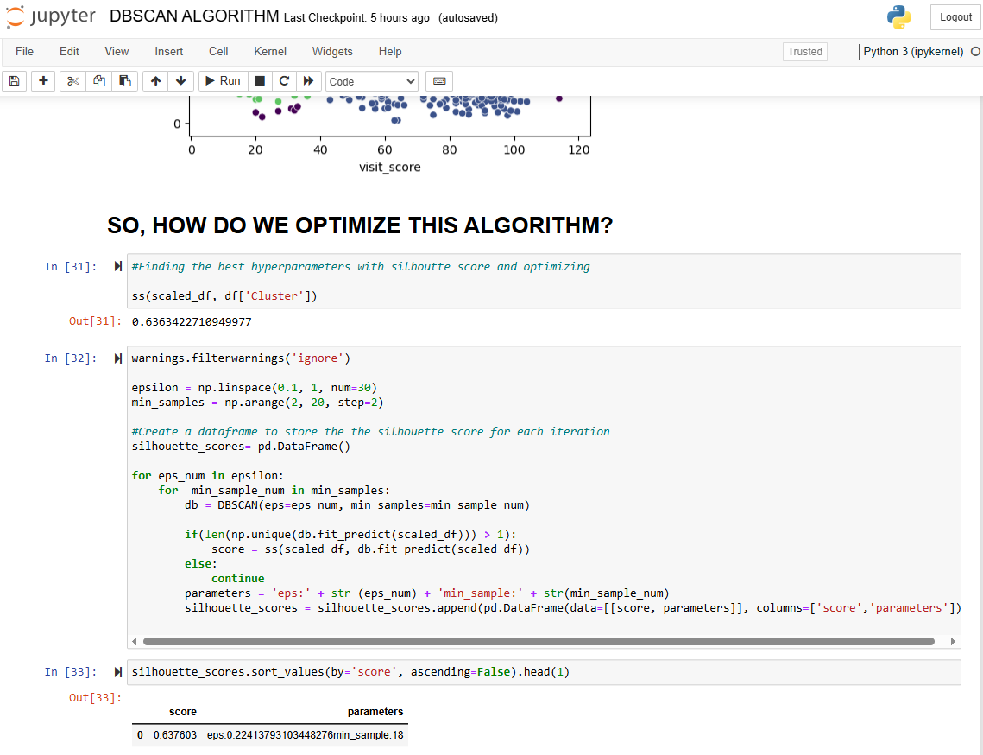
HOW THE ALGORITHM WORKS

Slide 13
OPTIMIZATION TECHNIQUES
HOW TO CHOOSE THE RIGHT eps AND min_samples
The eps value defines the neigborhood size.
K – Distance plot
Silhouette Score Optimization
GridSearchCV
Randomized Search
Bayesian Optimization
A good rule of thumb is 2* number of dimensions

Slide 14
APPLICATION OF DBSCAN
Anomaly Detection (e.g., Fraud detection, Cybersecurity)
Customer Segmentation (e.g., e-commerce, marketing)
Image Segmentation (e.g., medical imaging, object detection)
Gps & Geospatial Analysis (e.g., traffic clustering)

Slide 15
SUMMARY
DBSCAN is great for density based clustering and anomaly detection.
There is no need to specify k, unlike Kmeans Clustering.
DBSCAN is best for data with arbitrary shapes, but it struggles with data with varying density.
Use silhouette score to evaluate performance.

Slide 16
References
https://medium.com/@sachinsoni600517/clustering-like-a-pro-a-beginners-guide-to-dbscan-6c8274c362c4
https://www.reneshbedre.com/blog/dbscan-python.html#google_vignette
https://dashee87.github.io/data%20science/general/Clustering-with-Scikit-with-GIFs/
https://www.geeksforgeeks.org/dbscan-clustering-in-ml-density-based-clustering/
https://www.kdnuggets.com/2020/04/dbscan-clustering-algorithm-machine-learning.html

